Slide 1
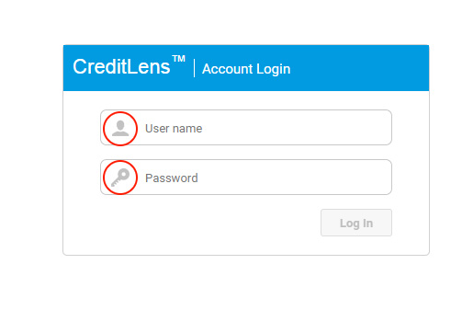
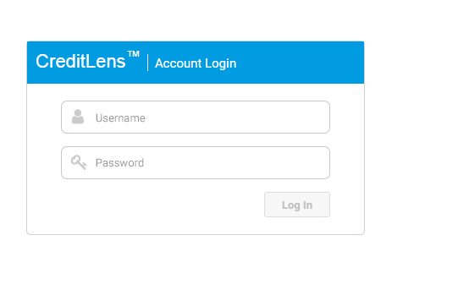
1) Change Login/Top Blue Bar Icons to FontAwesome
2) Change all dotted/dashed borders to solid

Slide 2
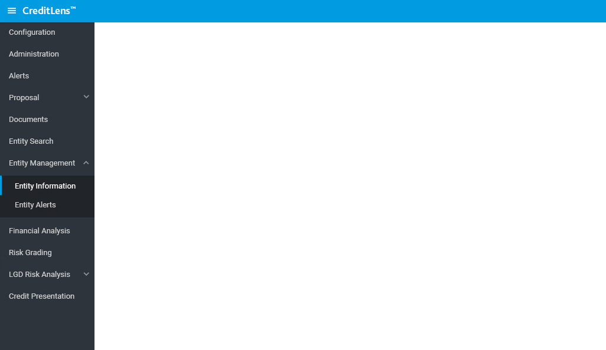
3) Left Menu Highlight Change

Slide 3
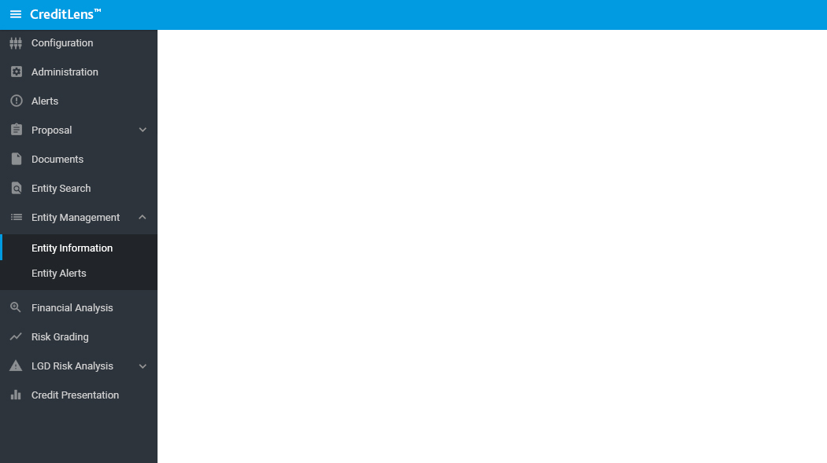
4) Bonus Story: Add Icons to Navigation

Slide 4

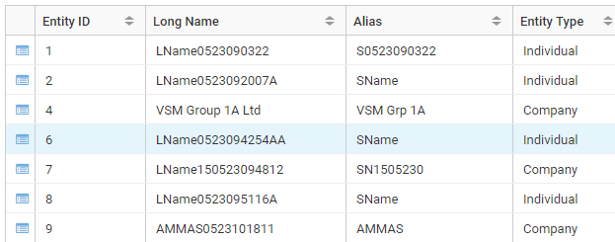
5) Remove button borders
6) Change green table highlight color

Slide 5
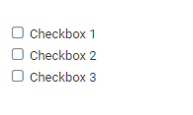
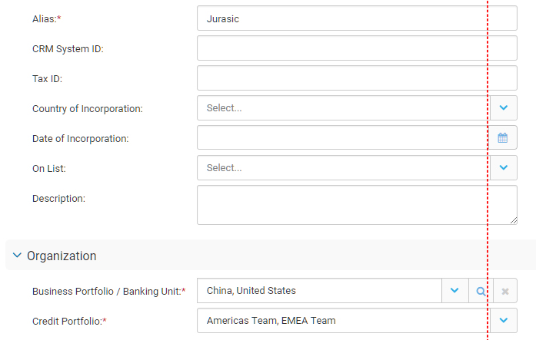
7) Larger checkboxes and align with content
8) Make form components the same size

Slide 6
9) Defect: Hamburger button causes a scroll bar to temporarily show during close of the navigation bar

